Slide 1
Sculpture
1950s

Slide 2
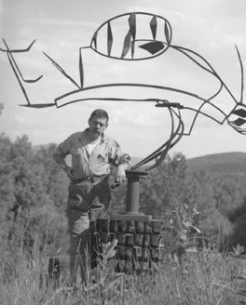

David Smith
Notes:
Just as Greenberg said art should be reduced to its most pure form, paintings being paintings, sculptures being sculptures, artists in the 50s tended to focus on one medium only. Sculptors such as David Smith often worked strictly in three dimensions rather than planning out pieces with drawings, even though he shared the tough guy attitude of his fellow abstract expressionists.

Slide 3
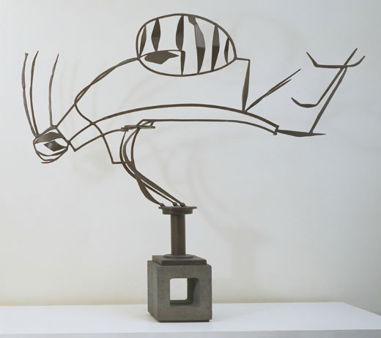
Notes:
David Smith's compositions were often made with found scraps of metal which he composed much as a painter worked with brushstrokes, adding a piece here, removing one there. Often there is an associative quality to these pieces as they look like figures or animals.

Slide 4
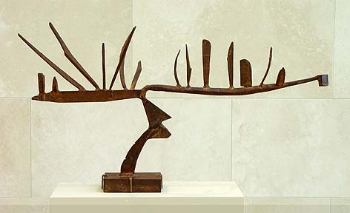
Notes:
The composition of these pieces can be talked about similarly to the composition of a painting, where certain forms balance out other forms. Additionally with sculpture there is the physical balance of weight as the weight of one piece balances against the weight of another one.

Slide 5
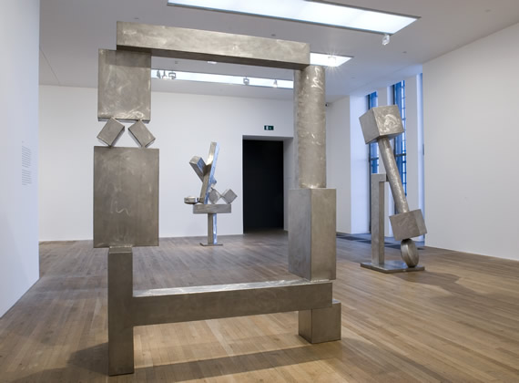
Notes:
Towards the end of his life Smith often worked with stainless steel to prevent his sculptures from rusting in outdoor environments. He had the ability to weld stainless steel but not to cut it so these forms were created with shapes he ordered pre-fabricated. This accounts in part for the much more geometric shapes in these later works.

Slide 6
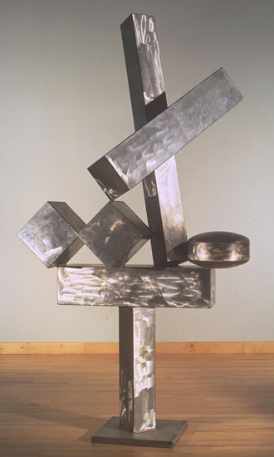
Notes:
This pieces demonstrate David Smith's ability to work in non-representational abstraction just as well as he handled representational abstraction.

Slide 7
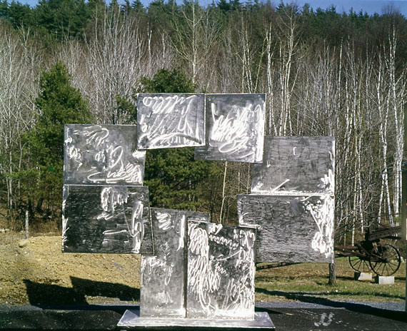
Notes:
The surface treatment of these pieces is created with a hand grinder. In the reflected sunlight in this photo you can see the expressive gestural marks this creates, much like the expressive brushstrokes of his fellow painters.

Slide 8
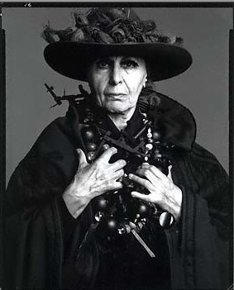
Louise Nevelson
Notes:
Louise Nevelson emigrated from Russia in her childhood and grew up to be an vibrant and flamboyant New York artist who could hold her own in the macho art world of the 1950s.

Slide 9
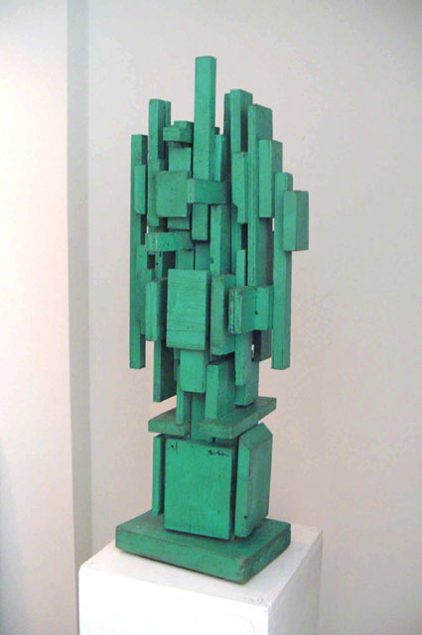
Notes:
Noticing the abundance of scrap wood and discarded furniture that she was able to find on the streets of New York, she started collecting the material and assembling it into sculptures.

Slide 10
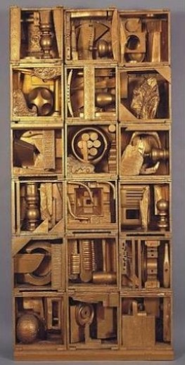
Notes:
Most of her pieces were presented against a wall, creating a definite front side, similar to reliefs in more traditional sculpture. Her found wooden objects were often arranged in stacked crates or boxes, lending an overall geometric structure to the work.

Slide 11
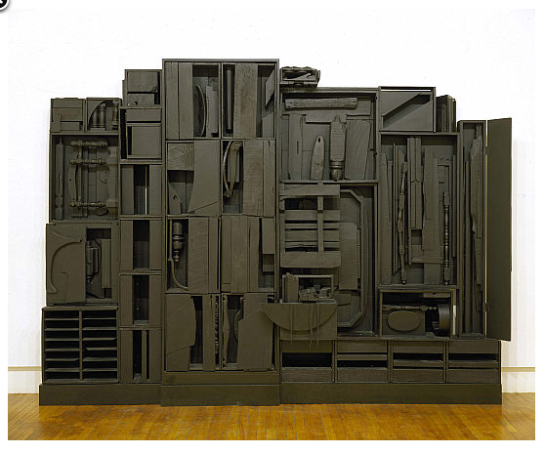
Notes:
The pieces were painted one color, usually black, to bring unity to the different shapes and to emphasize form over color.

Slide 12
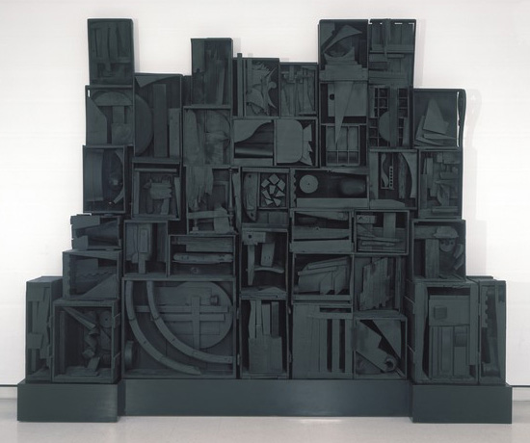
Notes:
Several of the pieces have titles like Cathedral or Nightscape, referencing their resemblance to the heavily decorated architectural facade of a cathedral, or a city skyline at night .

Slide 13
Images:
David Smith
Australia 1951
9/15/53 1953
installation shot, cubi series
Cubi XIX, 1964
Candida, 1965
Louise Nevelson
Untitled, 1950
Royal Tide, 1960
Nightscape, 1958
Sky Cathedral, 1958
Notes:
David Smith
Australia 1951
9/15/53 1953
installation shot, cubi series
Cubi XIX, 1964
Candida, 1965
Louise Nevelson
Untitled, 1950
Royal Tide, 1960
Nightscape, 1958
Sky Cathedral, 1958

